Slide 1
Human Beverages
Water
Amended water (soda)
Fruit juices
Stimulant beverages
coffee, tea, cocoa, mate
Alcoholic beverages
wine (fermented to brandy)
beer (fermented to whiskey)
vodka (potatoes)
pulque (fermented from agave)

Slide 2
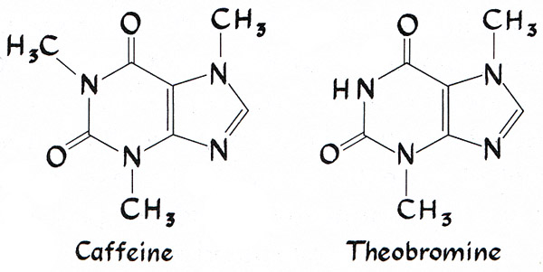
Major beverages (alcoholic and non-alcoholic) are consumed not only to quench thirst but to provide a mild stimulant or “lift.”
Nonalcoholic beverages such as coffee, tea, mate, cocoa do this by the presence of an alkaloid (caffeine or theobromine—which differ by a mere methyl group).
Typically their taste is an acquired one; thus none of these major beverages are initially liked by children unless sweetened.
Alkaloids: Cyclic Nitrogen Compounds

Slide 3
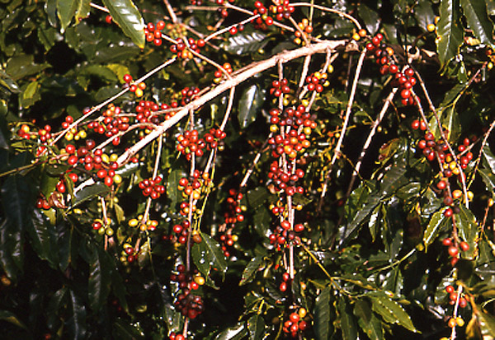
Coffee

Slide 4
History of Coffee
Coffee, traditional morning “eye opener,” is widely consumed as a pick-me-up break the world over in various ways including steeped, steamed, or boiled.
The plant originated in Africa, and entered Arabia (Yemen) from raids into Abyssinia now Ethiopia (Mocha, a slang name for coffee is derived from the city of Mocha (Al Mukha in Arabic) in southern Yemen on the Red Sea.

Slide 5
African natives chewed leaves and berries as a stimulant.
Coffee was grown as early as the 7th century in Arabia and neighboring countries.
Ground roasted “beans” (the seeds) are steeped in water to make the familiar beverage which is usually consumed hot.
Coffee was introduced into Southern Europe by Arab traders in the late Middle Ages but was not widely known in Europe until sea routes to the East were opened by the Dutch and English in the 17th Century (1615).

Slide 6
Coffee houses were established in England, the Netherlands and elsewhere in Northern Europe about 1650, later in the American colonies.
Coffee houses became social, literary, and political centers (Lloyds of London originated in a coffee house).
Interestingly, this is being repeated today as interest in espresso, coffee, cappuccino, etc. has become a new fad in American culture.
Presently the main center of production is the New World, particularly Brazil and Colombia.

Slide 7
2001 World Production
Continent | 1000 tonnes | Chief countries
World total | 7,044
Africa | 1,160 | Ivory Coast (280), Ethiopia (228), Uganda (197)
North America | 1,293 | Mexico (330), Guatemala (276), Honduras (206)
South America | 2,742 | Brazil (1780), Colombia (560), Peru (158)
Asia | 1,765 | Viet Nam (800), Indonesia (377), India (301)
Oceania | 84 | Papua New Guinea (84)

Slide 8
Botany
Over 25 to 100 species native to tropical Africa,
but some in SE Asia.
Related species are Cinchona spp., source of quinine.
Four important species of Coffea:
C. arabica, 90% of world’s coffee; self fertile;
6–8 months from bloom to ripening.
  Two subspecies:
    var. arabica common in Brazil and East Africa, dominant type in Asia
    var. bourbon, from Reunion, formerly Bourbon,
    an island 400 miles east of Madagascar.
    A high altitude coffee.

Slide 9
C. canephora
  Known as Robusta coffee; 9% of world’s coffee;
  9–11 months from bloom to ripening; self sterile;
  indigenous to African equatorial forests and thus a lowland coffee; vigorous growth, productivity and disease resistance.
  Quality inferior to C. arabica in flavor and aroma, but seems to be increasing with production of instant coffees.
C. excelsa
Vigorous; ripens 11–12 months from bloom.
C. Liberica
Ripens 14 months from bloom; 1% of world’s coffee.

Slide 10
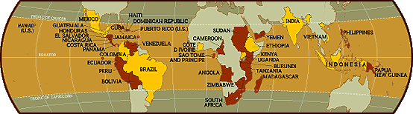
Coffea represents understory vegetation of tropical forest.
Best adapted 4500–6000'; it is grown in full sun in Brazil because not enough moisture for shade trees.
The tree is 15 to 40' when mature but some dwarf types. Adapted from 28°N to 34°S; sea level to 7000'.
Rainfall is critical.
Average annual temperature of 70°F.
Frost and cold can damage coffee; freeze can kill.

Slide 11
Morphology
Coffee is dimorphic composed of two types of growth: spreading (plagiotropic) or upright (orthotropic).
Cuttings and grafts from vegetative uprights give upright growth; cuttings from horizontal (plagiotropic) growth give trees that sprawl on the ground and are worthless.
This is the reason seed propagation gives desirable trees.

Slide 12
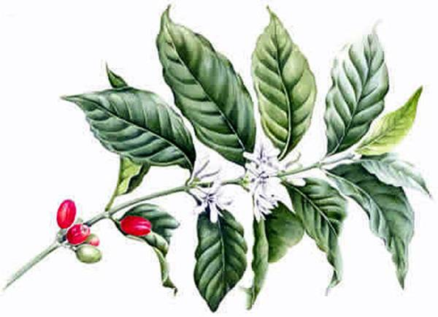
Plagiotropic Growth

Slide 13
Yields
Highest yields (2000 lb/acre) are found in Hawaii
(Kona coffee).
Coffee could not compete in Hawaii because of high labor costs, but is making a comeback with resurgence of interest in gourmet coffee and the tourist industry.
Kona coffee is being sold at $10–15/lb to tourists and cannot meet demand.
At the present time when you by Kona coffee it is diluted with cheaper coffees.
In Brazil yields are usually 400 lb/acre.

Slide 14
Diseases
Rust due to Hemileia vastatrix has caused collapse of coffee in Ceylon and Java.
This disease is not as serious with robusta coffees if shaded and therefore C. canephora is replacing
C. arabica in some areas.
Rust has now appeared in the Americas.

Slide 15
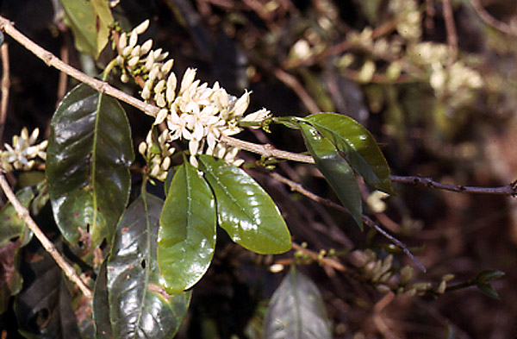
Coffee in bloom

Slide 16
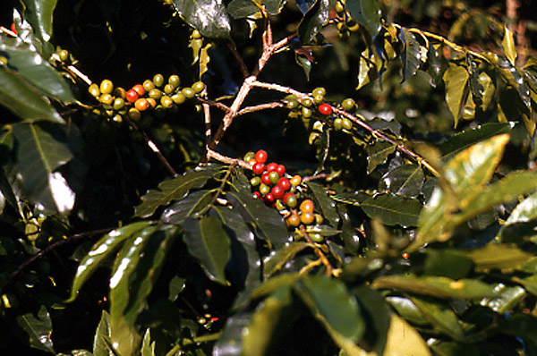
Ripening Coffee

Slide 17
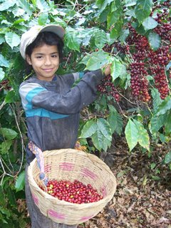
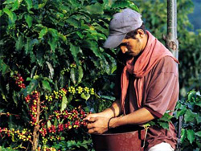
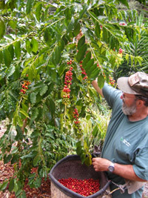
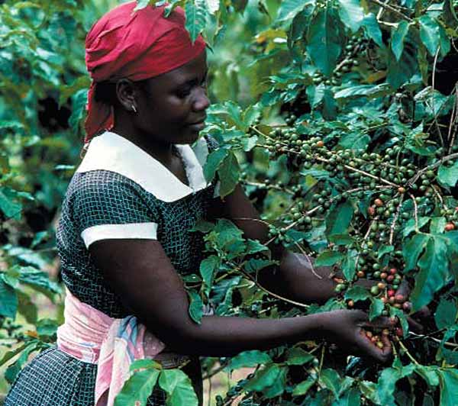

Slide 18
Processing
The ripe coffee “berry” (a fruit) consists of seed covered by a silvery testa (silverskin), a parchment layer, flesh, and skin.
The seed is mostly endosperm, and it is the endosperm not the embryo that produces the coffee flavor.
Note that all the layers must be removed in processing to produce the seed.
Seed consists mainly of green, corneous endosperm with a small embryo near the base.
Dried seeds after removal of silver skin provide the coffee beans of commerce; 5–6 lb of cherry
(whole fruit) provides ~1 lb of clean coffee; 1,000-dried seeds/lb.

Slide 19
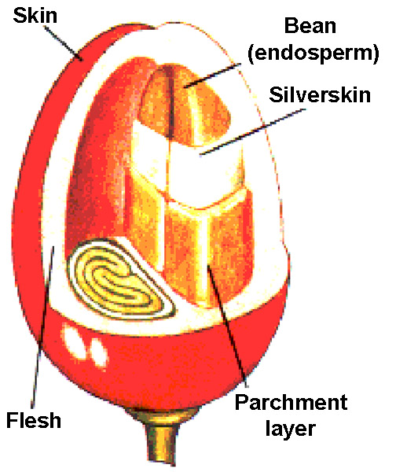

Slide 20
Two main types:
Wet processing (most common)
This requires abundant water.
  Flotation: Defective berries are first separated by floatation, good ones sink.
  Pulping and separation: Ripe berries run through machines which pulls of skin and most of the flesh.
  This must be done within 24 hours with red ripe fruit to prevent overheating and tainting of “beans” from rotting pulp.

Slide 21
Berries from separator are washed
Put in fermentation tanks to remove flesh adhering to parchment coat (18–24 hr) up to 80 hr if elevation is high and temperatures are cool.
Washing
Curing
Hulling or picking off parchment layer and silverskin by machinery.
  Seeds become shiny after polishing (removal of silverskin).
  Grading by weight and size.
  Often picked over by hand to remove stones, black beans etc.
  Now electronically sorted in advanced operations.

Slide 22
Dry Processing
Fermentation step is eliminated.
All stages of berries are dried in heaps
(15–25 days) and dehusked.
Often moistened to remove silverskins.

Slide 23
Economics
Economy of coffee has been disturbed by boom and bust economies.
Gluts cause low prices; government usually buy and store coffee to protect prices but system collapse when stored coffee gets to high levels resulting in dumping.
Rust is now a major problem causing shortages and high prices.
The interest in decaffeinated coffees has increased the importance of African robusta.

Slide 24
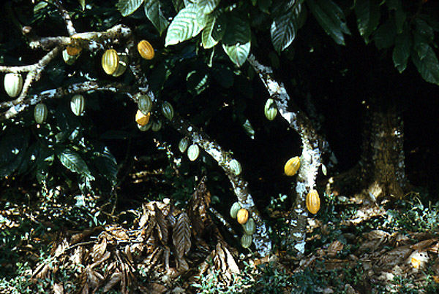
Cacao

Slide 25
Cacao (Theobroma cacao, Sterculiaceae)
Terminology:
  Cacao: The specific epithet of Theobroma cacao and the name of the tree.
  Cocoa: The drink produced from cocoa powder (also cocoa tree).
  Cocoa powder: The defatted ground up fermented seed of cacao.
  Cocoa butter: The fat expressed from cacao seed.
  Coca: The name of the plant producing the stimulant cocaine (Erythroxylum coca).
  Cocos: The name of the coconut palm
  (Cocos nucifera).

Slide 26
History
Indigenous to the New World, new evidence dates to 500 BCE in Maya culture.
Indians of Northern South America, Central America, and Mexico consumed a strong bitter, semisolid aromatic beverage made from the seed.
Beans were so valuable they were also used as money
(1 slave = 100 beans).
The generic name Theobroma means “drink” (broma) of the “gods” (Theo).

Slide 27
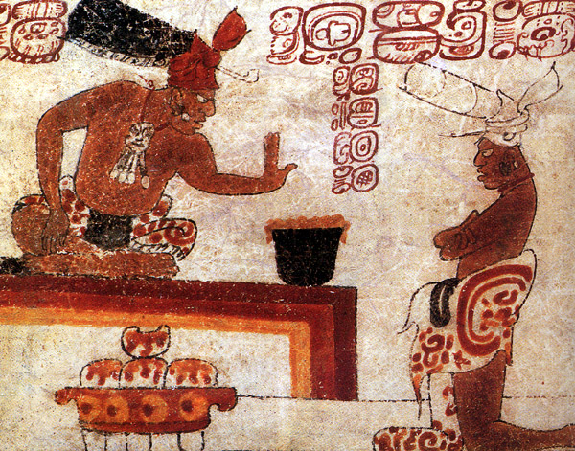
Detail of a palace scene on a Late Classic Maya vase.
The ruler gestures towards a pot of foaming chocolate; below the throne is a dish heaped with sauce-covered tamales.

Slide 28
Remained as a curiosity in Spain until Spanish added sugar, vanilla, and cinnamon to produce the well known beverage cocoa, which became popular in Europe by the middle of the 17th century.
(Featured in Mozart’s opera Cosi Fan Tutti ca. 1791 as a drink of the upper classes.)
Consumption, however, did not increase rapidly until the latter half of the 19th century.

Slide 29
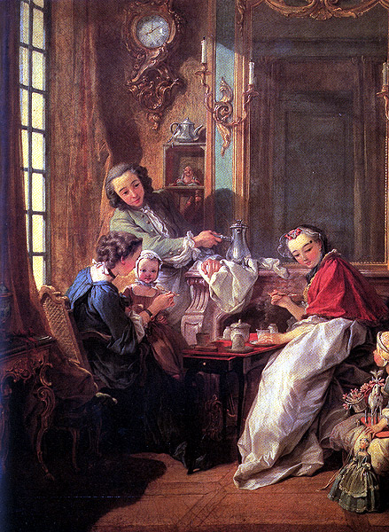
The typical French chocolatiere can be seen in this painting by Francois Boucher,
Le Dejeuner, 1739.

Slide 30
In l848, C.J. van Houten discovered a method for extracting part of the fat (cocoa butter) from the seed in the hot press process.
This produced a new product, cocoa powder, the defatted residue.
Defatted cocoa diluted with starch e.g. corn or arrowroot is popular as a drink in the British navy.
Cocoa butter was then found to a delectable product by adding sugar, cocoa power and molding it into bars—eating chocolate.
Sold by Fry and Sons (1817) and Cadbury (1849).
Milk chocolate produced in 1876 a chocolate suspension in milk, now an important world product
(Mars, Hershey, Nestle, Cadbury).

Slide 31
Cacao World Production (2005–2006)
Continent | 1000 tonnes | Chief countries
World | 3,731
Africa | 2,666 | Ivory Coast (1,410), Ghana (591)
Americans | 439 | Brazil (162), Equador (115)
Asia | 626 | Indonesia (520), Malaysia (27)

Slide 32
Botany
Related plants include Cola acuminata (cola nut, one of the flavorings of Coca Cola), Sterculia foetida, a tropical ornamental, Sterculia urens, source of karaya gum.
Note the name of the family, Sterculiaceae, refers to the vile smelling flowers of Sterculia foetida.
Sterco is the Latin name for dung (manure).
A related species Theobroma grandiflorum (cupuaçu) is cultivated for the strongly flavored pulp.

Slide 33
Ecology
Cultivated in tropical lowlands 20°N to 20°S but main belt is 10°N and S from sea level up to 500 m, best at 200 to 300 m.
Needs constant rain, 1500 to 2000 mm (60–80").
Thrives in diverse soils.
Usually grown under nitrogen fixating leguminous shade trees to provide organic matter.

Slide 34
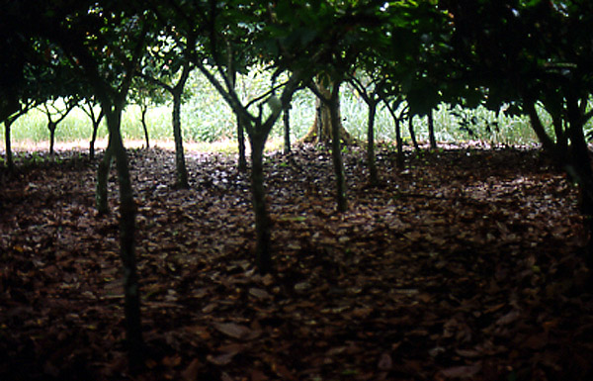

Slide 35
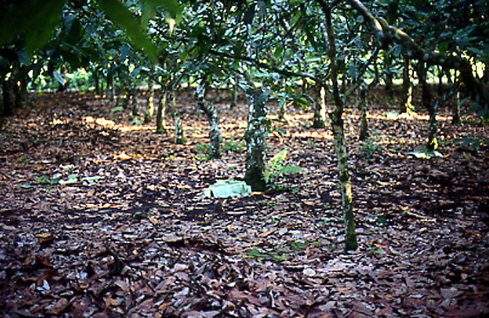
Cacao

Slide 36
Traditionally Cacao is Classified into Two Races
Criollo
  (cacao dulce, or sweet cacao) native to Central America, considered the best flavored.
Forastero
  (cacao amargo or bitter cacao) native to Venezuela and the northern Amazon.
  Many types of forasteros.
Trinitarios
hybrids between these types, based on crosses made at the Trinidad Imperial College.
  Most of the present cacao seem to be hybrids between these types.

Slide 37
Tree is 5–8 m, (15–40') tall, grown as an understory tree. Small flowers are borne directly on branches (cauliflorous flowering).
Pollination is by insects particularly midges such as Forcipomyea.
Pollination is one of the principal problems of cacao.
A number of crosses are incompatible, typically due to embryo abortion.

Slide 38
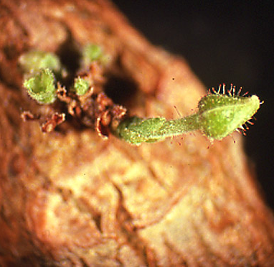
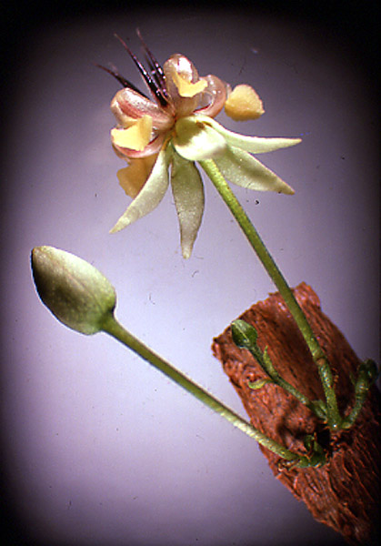
Cauliferous Flowering in Cacao

Slide 39
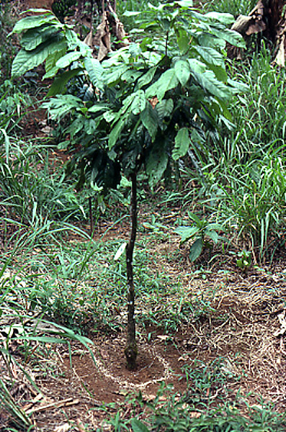
Cacao,
Orthotropic Tree

Slide 40
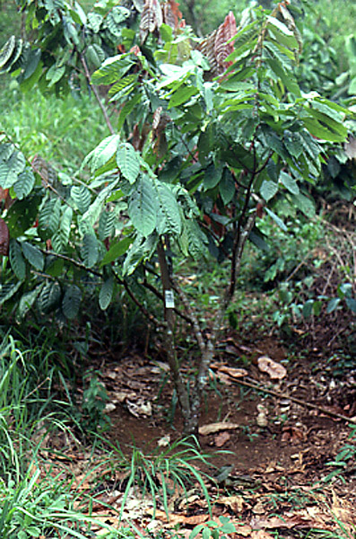
Cacao,
Plagiotropic Tree

Slide 41
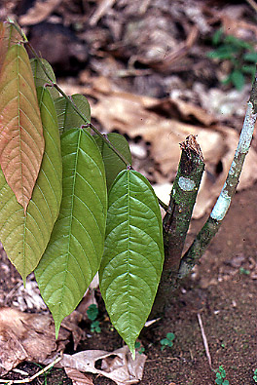
Budded Cacao showing plagiotropic growth

Slide 42
Fruits are pods, usually 10–32 cm long, usually football shaped and furrowed, warty, green yellow or red in color.
There are 20 to 60 seeds (called beans) surrounded by a sweet delicious pulp that is sometimes collected as a source of jelly or frozen as a flavoring for yogurts or ice-cream.
Seeds usually constitute 25% by weight of the mature fruit; there are 250–450 dry fermented beans per lb.
Fruits are harvested with a knife blade at the end of a long pole.
Harvesting is carried out continuously throughout the year.

Slide 43
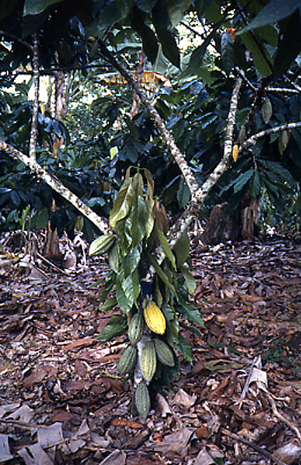

Slide 44
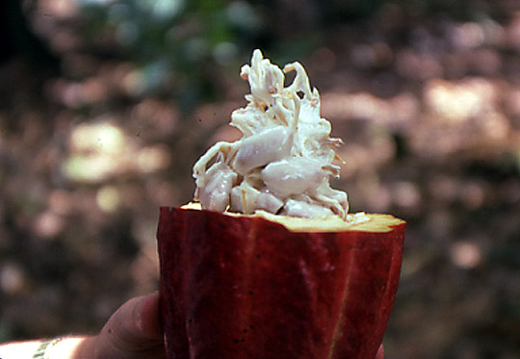
Cacao

Slide 45
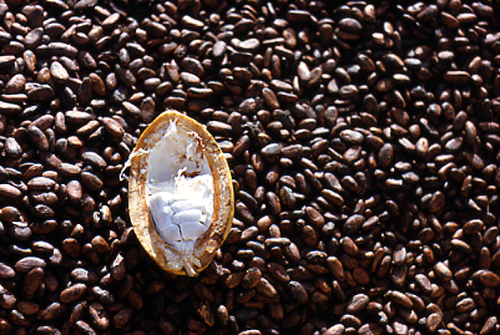
Cacao fruit and dry beans

Slide 46
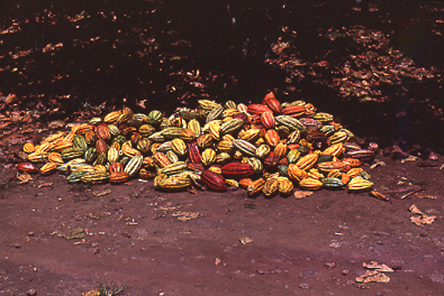
Cacao fruit

Slide 47
Cacao Diseases
Two serious diseases
  Blackpod (Phytophthora palmivora) is serious in Africa.
  Witches broom (Marasmium perniciouses) is now destroying the Brazilian industry.

Slide 48
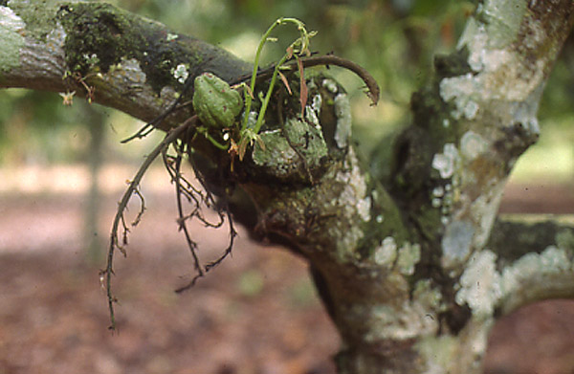
Witches’ broom

Slide 49
Field Processing
Fermentation
After harvest, seeds and pulp are scooped out of the fruit by hand and left to ferment into heaps (often in wooden boxes) for about 36 hr at 40–50°C.
Two processes are involved.
Decomposition of sugars in the mucilaginous pulp around the beans to alcohol and CO₂ by yeast and from alcohol to acetic acid by bacteria.
  Pulp liquefies and drains away.
  Thus, one of the reasons for fermentation is to get rid of the pulp (which could be utilized as a byproduct).

Slide 50
2. Internal changes.
  Aeration is necessary for these changes thus piles of beans are transferred from box to box for aeration.
  Embryo dies and seed coat changes color.
  Bitter seed substances are converted to milder flavored components and chocolate aroma is developed.
  The aroma is produced by cacaool, 23 ml/ton.
  Thus, fermentation is critical for high quality.
  Over fermentation leads to offensive flavor; under fermentation leads to bitter taste.

Slide 51
3. In some cases seeds are washed but this stage is usually omitted.
4. Seed drying for 36 hr, moisture is reduced from 33 to 8%.
  Slow and even drying is important.
  Thus, the seeds are often shaded in the warmest part of the day and raked.
  100 kg of wet seed reduces to 45 kg of dry seed because of loss of moisture and changes that occur during the process.
5. Sorting, grading, bagging, and storing.
  The bagged seed are exported to chocolate processing facilities, usually in the temperate world.

Slide 52
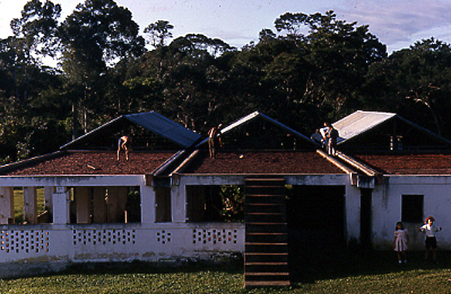
Drying cacao

Slide 53
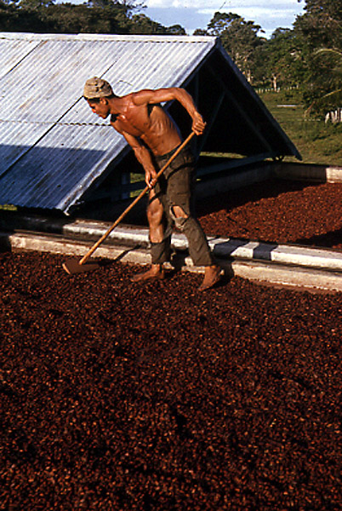
Raking cacao while drying

Slide 54
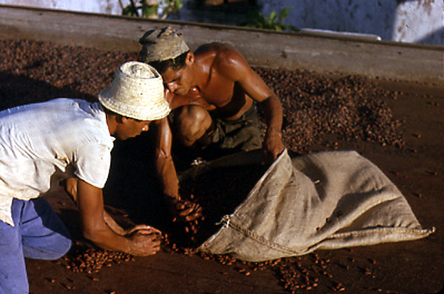
Bagging cacao

Slide 55
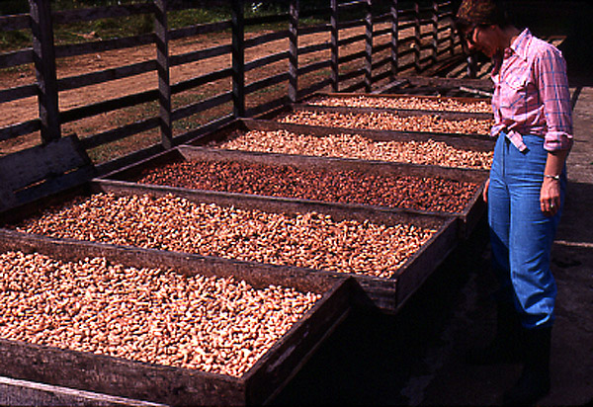
Cacao drying

Slide 56
Cacao Processing
Three steps: cleaning, roasting, and winnowing to remove the shell from the “nibs” or embryos.
The byproducts of cacao harvest are the pods which can be ground into meal.
However, the alkaloid content (theobromine) makes them unsuitable unless diluted with other feeds.
The seed coat or shell (from cacao processing) makes an excellent horticultural mulch.
The mucilage is a wasted resource and could be a valuable food product.
There are also mucilaginous compounds in the shell which could be a source of gums similar to karaya gum.

Slide 57
The cocoa butter is more valuable than the cocoa power because when chocolate is made cocoa powder is left over and is thus in surplus compared to the fat.
The fat has very peculiar properties melting at body temperature and giving a creamy texture.
It is composed of almost equal parts of palmitic acid (C16:0), stearic acid (C18:0), and oleic acid (C18:1) with only small amount of linoleic acid (C18:2).
Cocoa butter substitutes are being produced but the chocolate must be labeled as artificial chocolate.

Slide 58
Production of Cocoa Powder
Liquor process.
The seed or nib is ground to a dark fluid brown liquor which can be molded and sold as unsweetened chocolate.
The liquor is pressed to extrude the fat or cocoa butter.
The press cake is sieved and is known as natural chocolate.
In the alkalization or Dutch process, the nib is soaked in alkali, dried, and pressed again.

Slide 59
The cocoa power with about 6% fat is known as breakfast cocoa.
In the manufacture of chocolate, cocoa butter and cocoa powder are recombined with the addition of sugar and flavorings such as vanilla.
The European preference is for dark, bittersweet chocolate; the US preference is for sweet, milk chocolate.

Slide 60
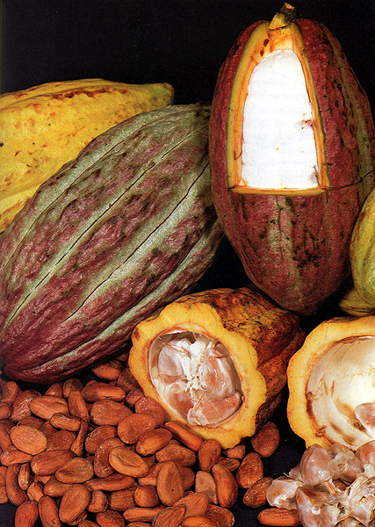
Through fermentation and drying, the cacao pod’s pulp-surrounded seeds are converted into nibs ready for roasting and grinding into chocolate liquor.

Slide 61
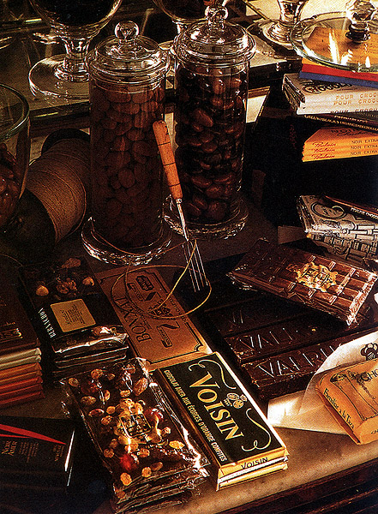
The end of the 20th century has seen a revival of luxury high-quality chocolate with a high content of cocoa solids and cacao butter.
These premier confections on display come from all over Europe.

Slide 62
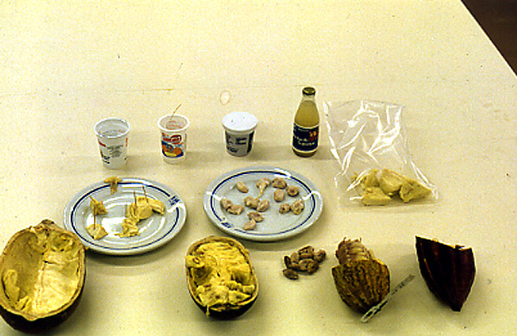

Slide 63
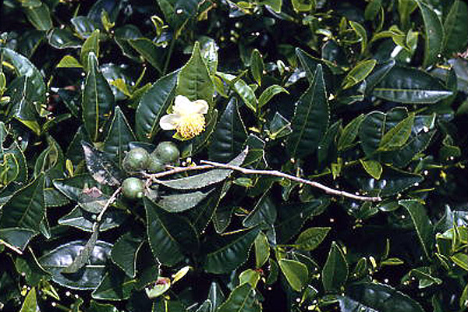
Tea

Slide 64
Tea History
Originated in SE Asia (western and southern China, Cambodia, Laos, Burma (Myramar), & NE India).
Long grown in China, earliest use was probably medicinal, but used as a beverage for 2000–3000 years.
First brought to Europe in the 16th century but did not reach eastern Europe until after 1650, when coffee drinking was well established.
Use became general in Europe in the 18th century and replaced coffee in Britain who spread the tea-drinking habit throughout their sphere of influence.
Tea ceremony in Japan is an important cultural heritage.
Boston Tea Party (1773)
Opium Wars (1839–1844)

Slide 65
Current Uses
Tea remains the most inexpensive beverage.
In the United States ice tea is very common in the South and is increasing in popularity. It is now canned as a noncarbonated soft drink.
Herbal teas made from other plants have increased in sales.
In Arab countries, especially in Morocco, infusions of tea plus mint are very common.

Slide 66
2001 World Production
Continent | 1000 tonnes | Chief countries
World | 3,059
Africa | 421 | Kenya (240), Malawi (45), Uganda (33)
South America | 70 | Argentina (50), Brazil (9), Peru (7)
Asia | 2,554 | India (855), China (711), Sri Lanka (295)
Europe | 5 | Russian Federation (5)
Oceania | 10 | Papua New Guinea (10)

Slide 67
Botany
An evergreen or semi-evergreen tree, 15 m tall but in commercial production tree is pruned to a shrub.
It is closely related to camellia.
There are two major groups of tea plus hybrids:
  Chinese teas (var. sinensis; syn = bohea, viridis, thea). These are the most adaptable teas, about 10 m tall. More tolerant to cold than assam teas.
  Assam teas (var. assamica) are fast growing tall trees, requiring high temperature.
    There are dark and light foliage types.
    The lighter the leaf, the darker the infusion but dark leaves have greater flavor and astringency.
  Djarling teas are hybrids between Chinese & Assam teas, so named because grown in Djarling, India)

Slide 68
Ecology
A subtropical plant adapted to temperatures between 13° to 30°C.
All of the subtropics and mountainous regions of the tropics are suitable.
When dormant it will withstand temperatures below freezing but N and S limits are set by 0°C winter isotherm.

Slide 69
Highest quality tea is produced in cool climates.
Most suitable areas have 100" of rain, evenly distributed.
Will not do well with less than 80" because shrub suffers under drought, but also declines with prolonged wet season because of reduced sunlight.
Requires deep friable soil.
At low elevations yield increases but quality declines.

Slide 70
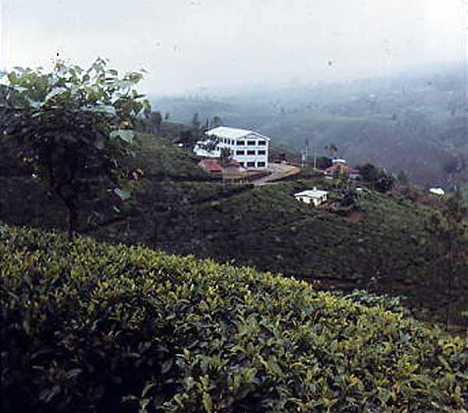
Tea estate, Ceylon, 1968

Slide 71
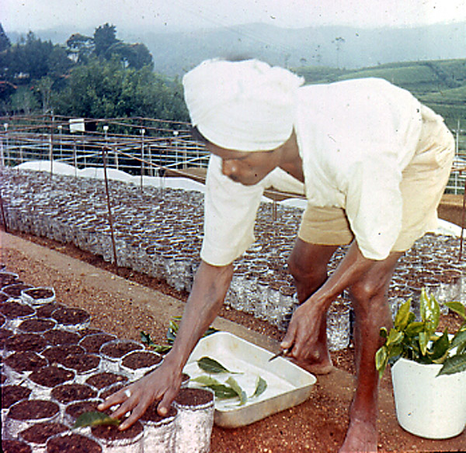
Propagation of tea, Ceylon

Slide 72
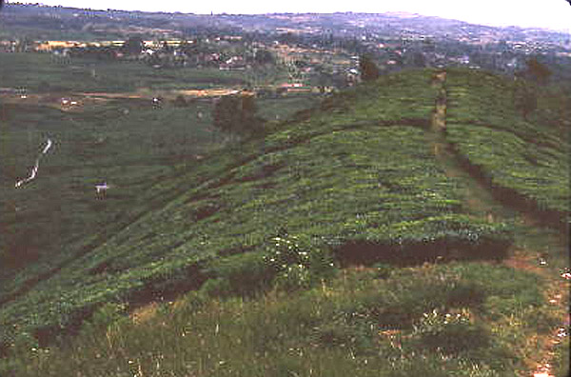
Tea on the road to Bandung, Java, Indonesia

Slide 73
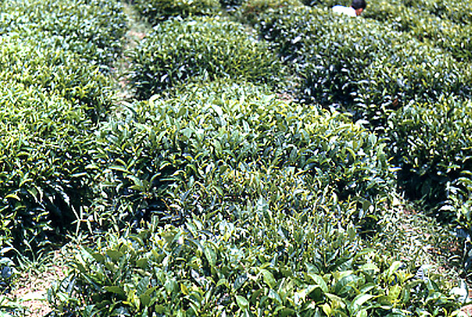
Asian tea propagated from seed

Slide 74
Harvest
A balance between quality (very young shoots) and yield is required.
Usually a terminal bud and two to three leaves are harvested by “plucking.”
Finer plucking give greater number of new shoots.
Coarse plucking gives higher yields at first and then adversely affect yields.
Quality increases with the frequency of harvest.
A typical cycle is harvest after 7 to 10 days.
Care must be taken not to bruise the leaves.
Mechanical harvesting carried out in Japan and Russia.

Slide 75
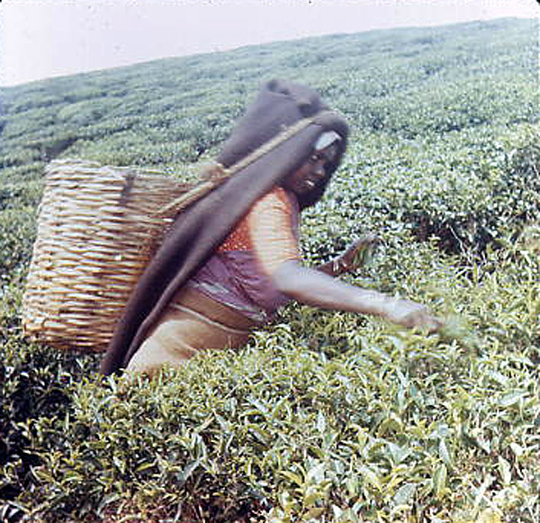
Tea plucker, Ceylon, 1968

Slide 76
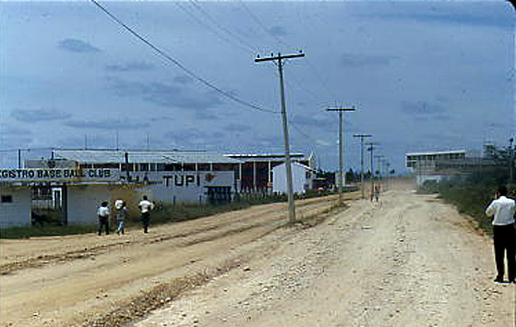
Tupi tea company, Registro, Sao Paolo, Brazil, 1965

Slide 77
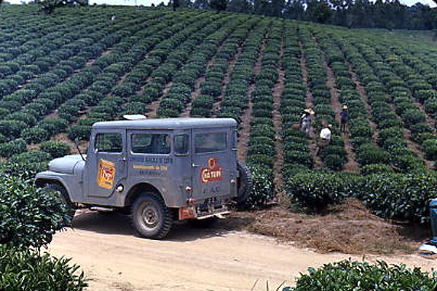
Tea fields

Slide 78
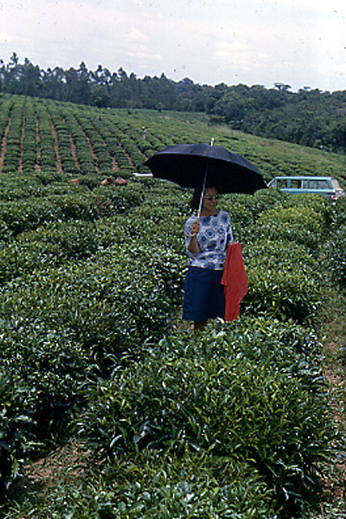
Shirley at tea farm

Slide 79
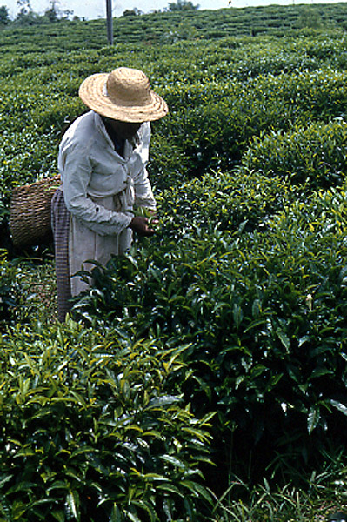
Harvesting tea

Slide 80
Processing
Three main types:
  Black tea—fermented tea
  Green tea—low volume, high quality, not fermented but heated first
  Oolong—partially fermented.

Slide 81
Four steps:
Withering and drying.
  Fresh shoots are 75–80% water, spread on trays, may be heated.
Rolling and sorting.
  Leaves are separated from the tips and crushed to distribute sap using a corrugated table and cylindrical rollers.
  First rolling without pressure for 1 hr; later rollings with increasing pressure and higher speed 45 to 60 min. (longer rollings stronger teas; less rolling lighter and more flavorful teas) followed by sifting and grading.

Slide 82
3. Fermentation. 21°–25°C, 90% humidity.
Complex biochemical changes; requires oxygen.
4. Drying. 20–25 minutes at 90° to 100°C, moisture reduces to 3–6%; sorting on screens.
5. Grading. Teas are graded on appearance, uniformity, and aroma.
  There are 3 grades:
  Leaf teas (orange pekoe—regular pieces with orange tip; pekoe; pekoe souchon; souchon)
  Broken teas
  Lower grades

Slide 83
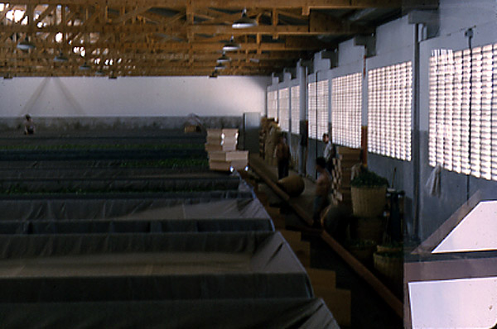
Tea factory in Registro, wilting room

Slide 84
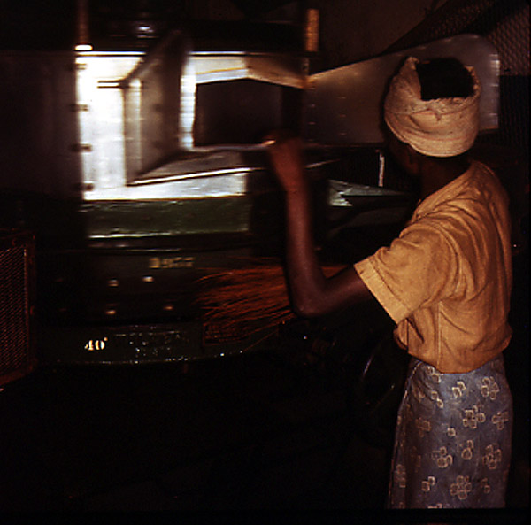
Rolling tea leaves before fermentation, Ceylon

Slide 85
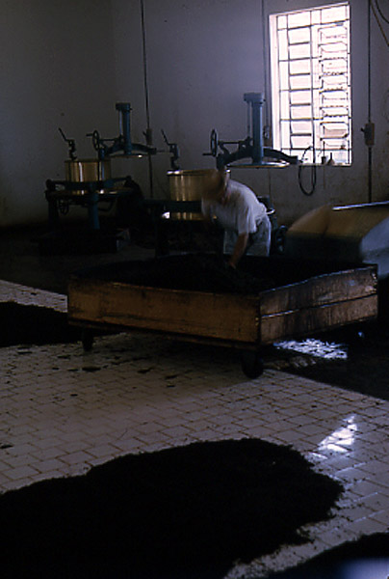
Black tea after fermentation

