Slide 1
Loquat Improvement
Jules Janick
Purdue University
West Lafayette, Indiana, USA
janick@purdue.edu
Notes:
It is a pleasured to be here in Providence at this celebration of the ASHS Centennial. I have been a member of ASHS for 51 years, and I am proud to be affiliated with this venerable Society. Now, 100 Years is a long time but yet I feel a connection to 1903. When I was a student at Cornell University Liberty Hyde Bailey was brought in to speak to my Vegetable Crops class, taught by Bob Sweet. Think of it; Bailey was born in 1858. The mystic chords of memory will be stretched today.

Slide 2
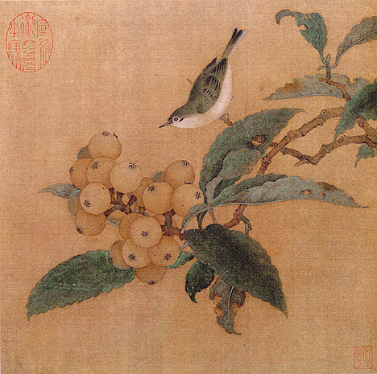
Loquats and a Mountain Bird
Southern Song Dynasty (1127–1279)

Slide 3
The Rose Family
The rose is a rose
And was always a rose;
But the theory now goes
That the apple’s a rose,
And the pear is, and so’s
The plum, I suppose.’
The dear only knows
What will next prove a rose.
Your of course, are a rose,
But were always a rose.
And now the book shows
And I now can disclose
That the loquat’s a rose.
We love it, wherever it grows!
Modified from Robert Frost

Slide 4
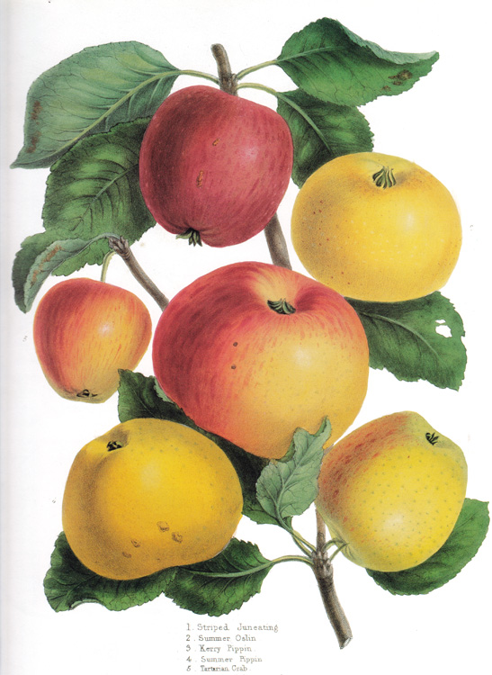
Fruit Crops of Subfamily Maloideae
Important
Apple (Malus × domestica)
Pears Pyrus spp.

Slide 5
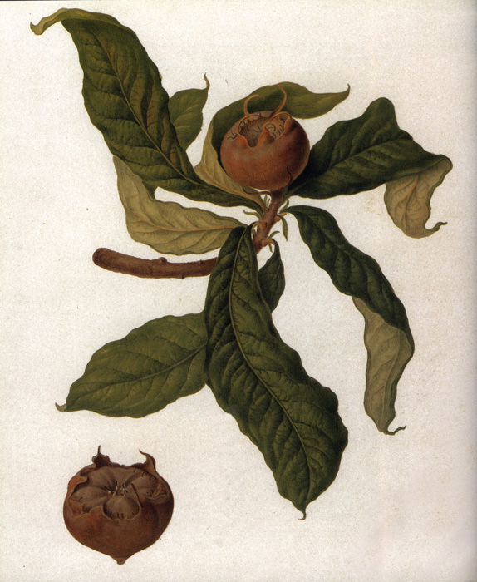
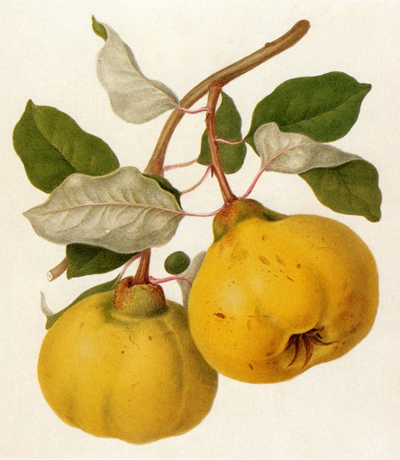
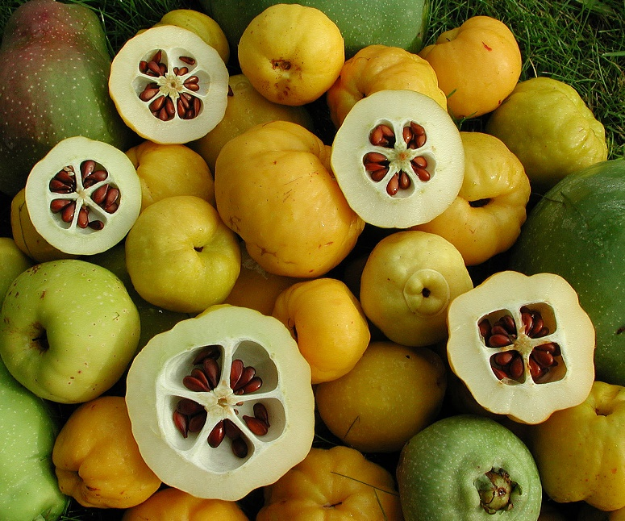
Declining
Quinces (Cydonia oblonga, Chaenomeles japonica)
Medlar (Mespilus germanica)
Quince
Asian Quince
Medlar

Slide 6
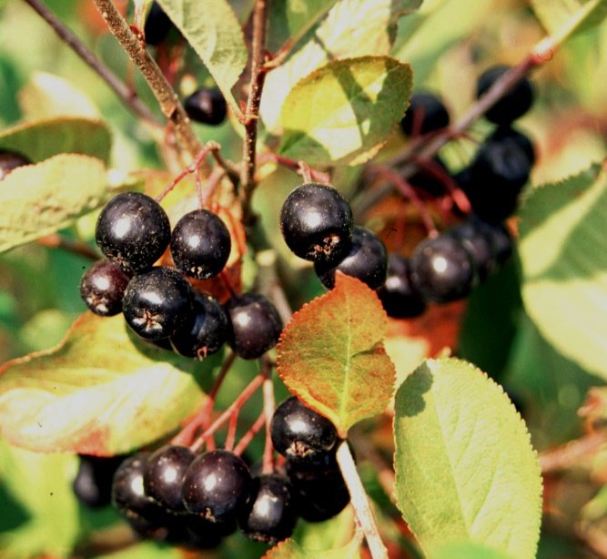
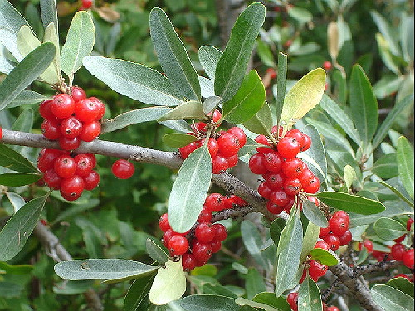
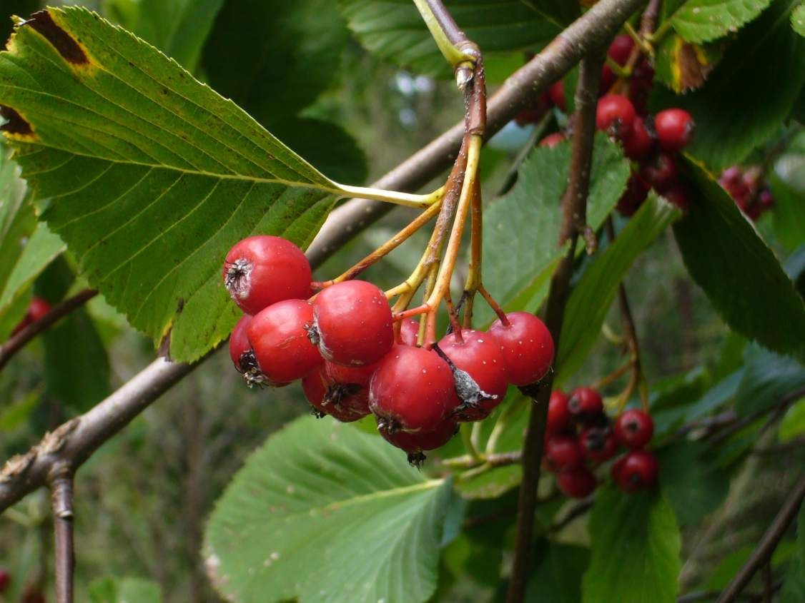
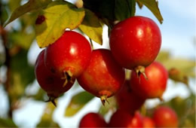
Minor and Ornamental use
Aronia (Aronia melonicarpa)
Hawthorn (Crataegus spp.)
Mountain Ash (Sorbus spp.)
Service berry (Amelanchier)
Aronia
Amelanchier
Sorbus
Crataegus

Slide 7
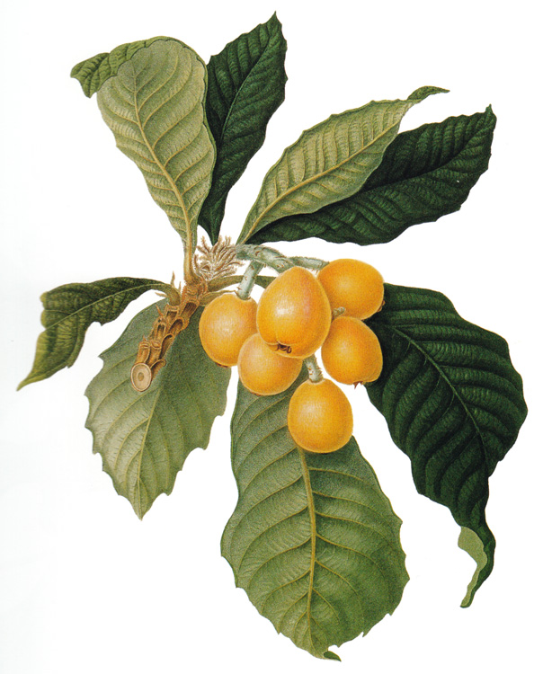
Increasing
Loquat
(Eriobotrya japonica)
Trans. Royal Hort. Soc. London, 1822

Slide 8
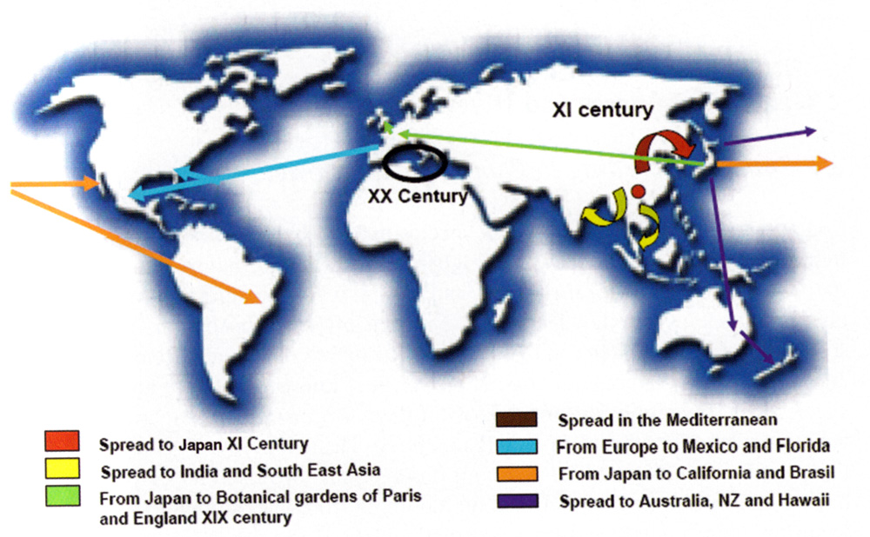
Origin and Spread of Loquat

Slide 9
Loquat Producers
Abkhazia
Albania
Algeria
Armenia
Australia
Bermuda
Brazil
China
Cyprus
Egypt
France
India
Israel
Italy
Japan
Lebanon
Malta
Morocco
New Zealand
Pakistan
Portugal
Slovenia
Spain
Syria
Turkey
United States (Florida)

Slide 10
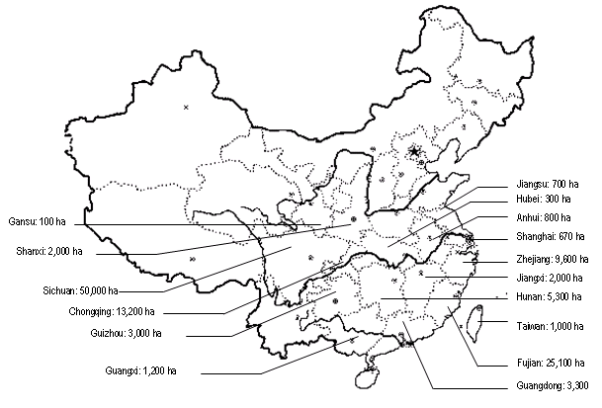
Loquat in China

Slide 11
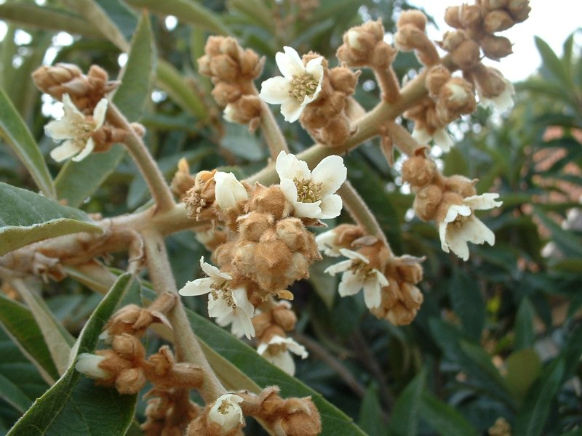
Blossoming Loquat

Slide 12
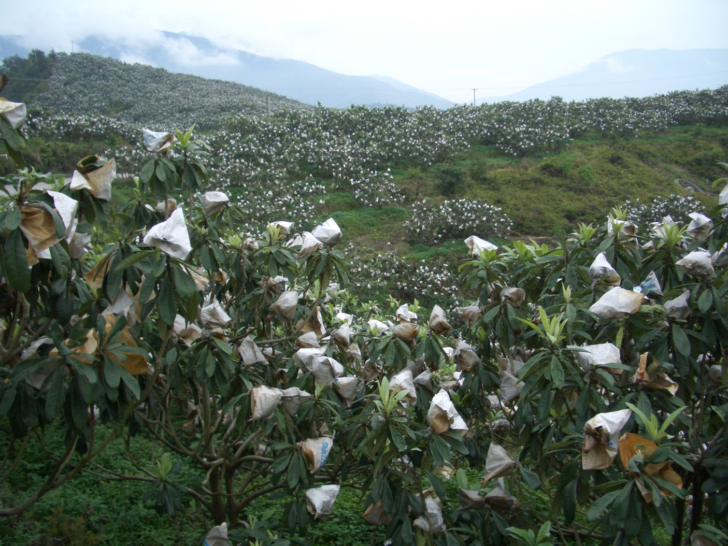

Slide 13
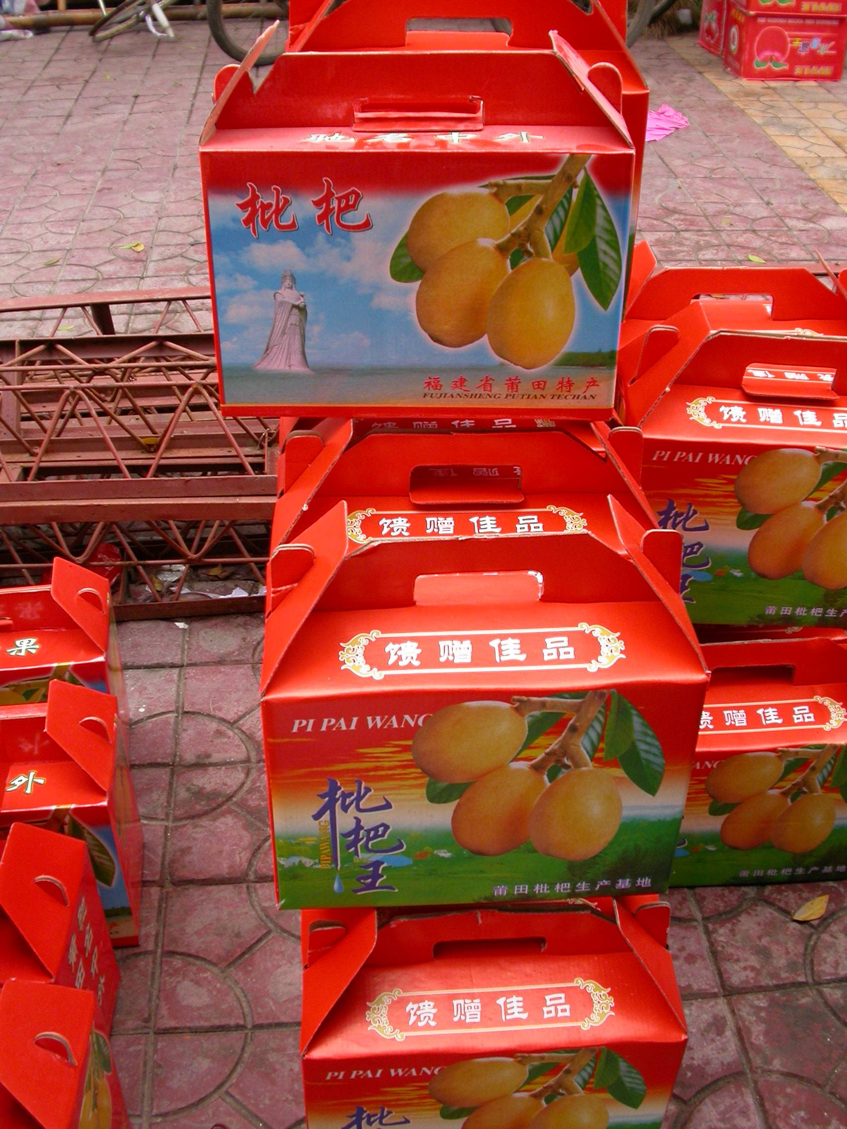

Slide 14
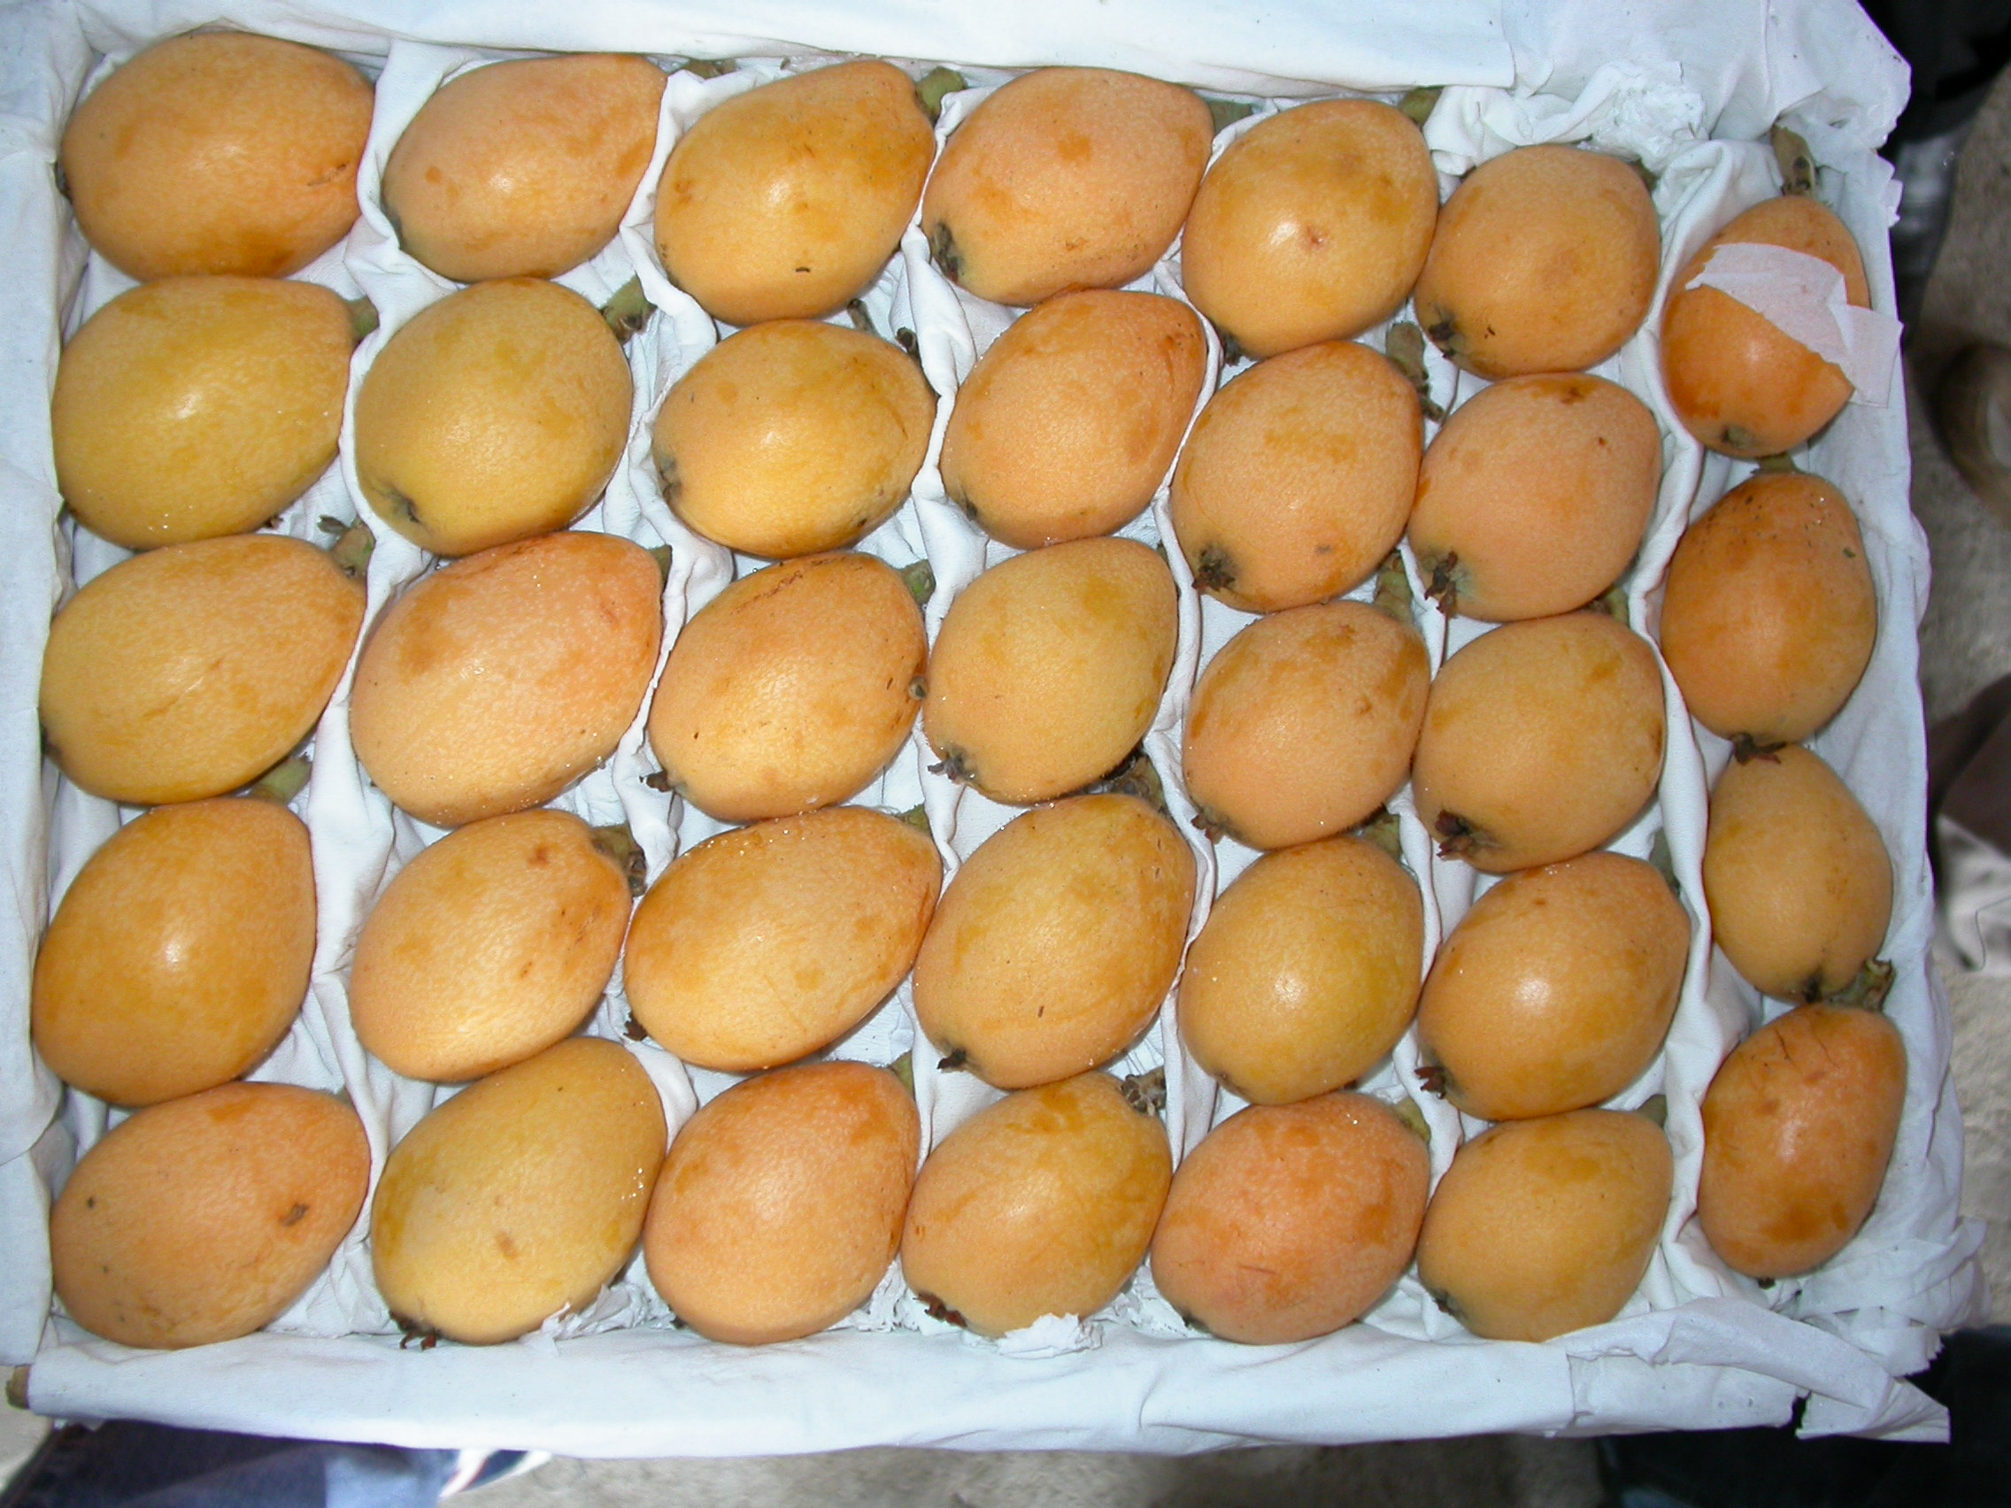

Slide 15
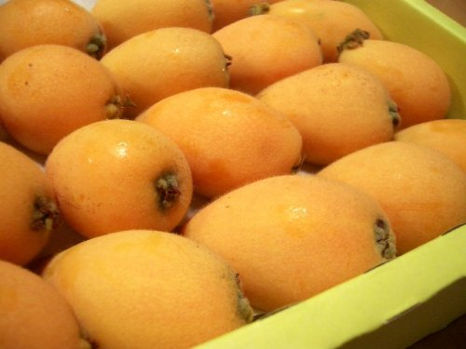
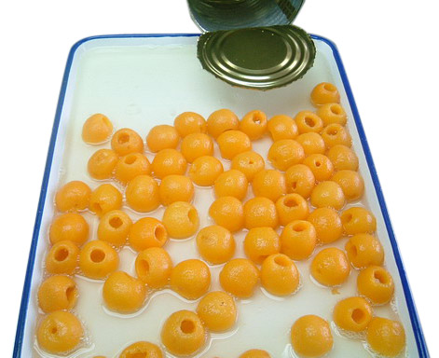
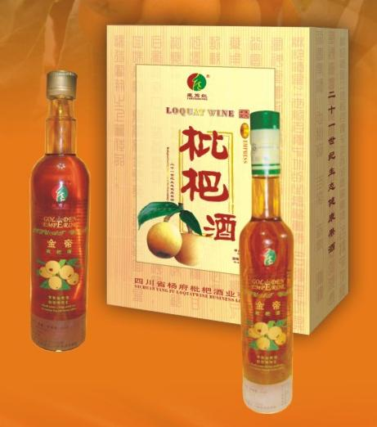
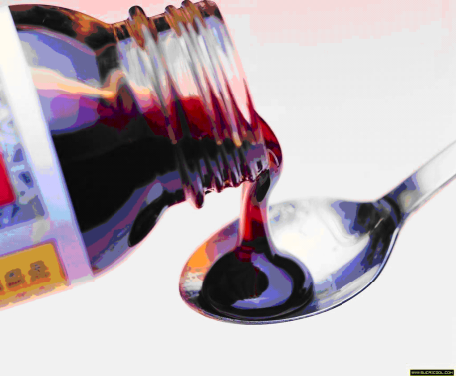

Slide 16
Rootstock Objectives
Compatibility
Deep rooting
Root:shoot ratio
Precocity
Dwarfing
Disease resistance

Slide 17
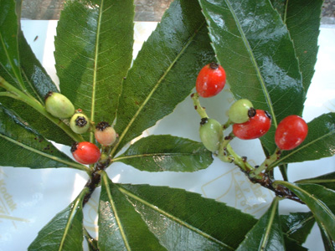
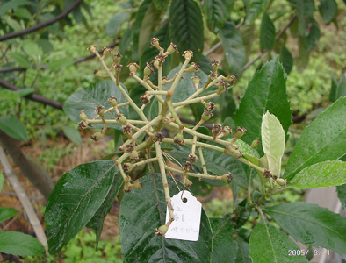
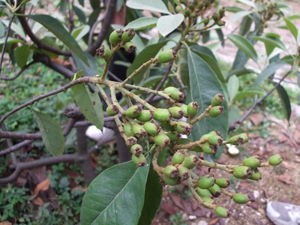
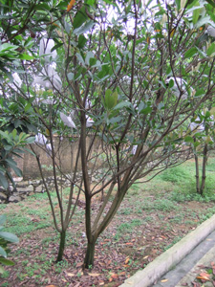
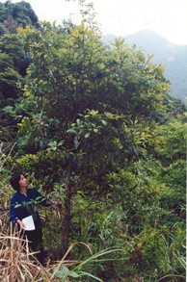
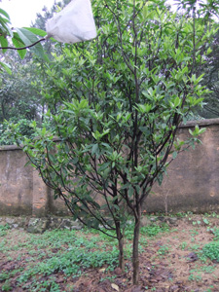
E. henryi
E. japonica
E. prinoides
E. deflexa
E. fragrans
E. kwangxinesis

Slide 18
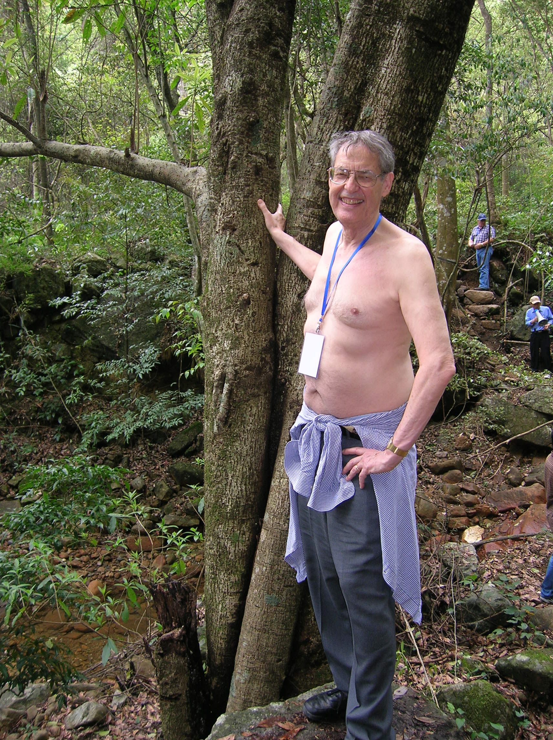

Slide 19
Genomics
Transfer of genes within the Rosaceae
  Nematode resistance
  Pathenocarpy
  Scab resistance
  Virus resistance
  Dwarfing (for rootstocks)
  Deep Rooting
  Root Shoot Ratios

Slide 20
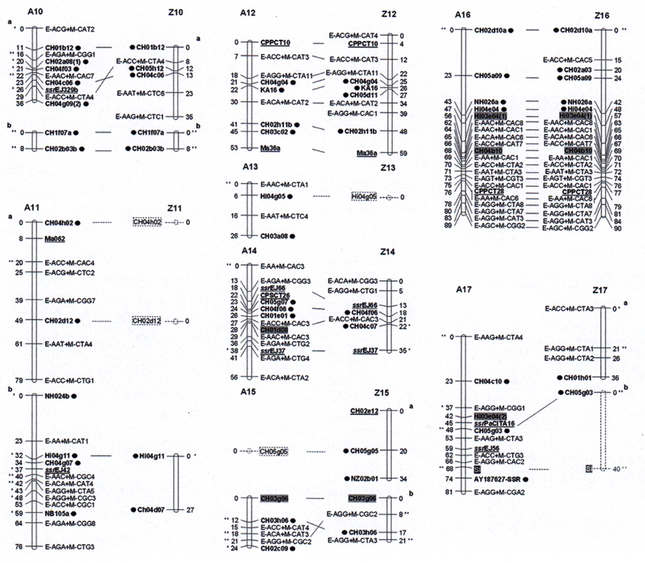

Slide 21
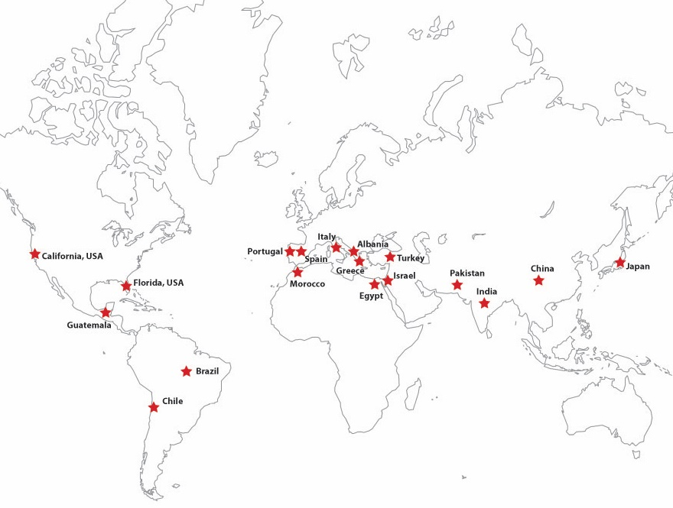

Slide 22
Brazil
J. Saval Brasil
Ronda Brasil
China
Changhong-3
Dazhong
Hongganben
Jiefanghzhong
Meihuaxia
Puxinben
Taicheng-4
Xiangzhong-11
Zaozhong-6
Japan
Mogi
Mogi Wasse
Tanaka
Italy
Bianco
Italiano-1
Marchetto
Ottaviani
Rosa
Rosa Tardío
Sanfilippara
Vaniglia Dulce
Virticchiara
Pakistan
Ikramullah-1
Ikramullah-2
Khyber-1
Saeed-1
Portugal
Almargem
Mata Mouros Regional
Rolhâo II
Tavira
Spain
Al-Ama
Alcácer
Alfons Gregori-1
Alfons Gregori-2
Algerie (Altea)
Algerie clon tardío
Barret
Benimelli
Beniaratx
Borde
Cabelo
Cambrils
Chirlero
Cort
Cox
Cremaor
Dama
Dulce Pera
Estrada Blanc
Estrada Groc
Paco el Gordo
IRTA
Ismael
Javierín
Joaquín Giner
Linares
Magdal
Magdal Carne Blanca
Maite
Manises
Marc
Mas Vagué
Masía Cañera
Manera
Mercedes
Mil Homens
Miquel d’Aixarà
Miquel Nucier
Nadal Tardío
Nadal Temprano
Peluches
Peix
Pere Esquena
Piera
Polop-1
Raúl
Redonet
Requina
Ronda Gruesos
Sacós
Saguntí
Sally
Samper-1
Samper-2
Saval-1
Saval-2
Saval Moreno
Saval Nerviado
Sisantanou
Siscar
Susana
Temprano de Petrés
Toni Tomaca
Vila
USA
Advance
Champagne
Golden Nugget
McBeth
Mrs Cooksey
Sabroso
Vista White

Slide 23
Most present cultivars are chance seedlings
Variability in cultivars include:
  External and internal color
  Size
  Flesh characters, taste, sweetness, acidity, texture
  Seed number
  Flesh thickness
  Keeping quality
  Disease resistance

Slide 24
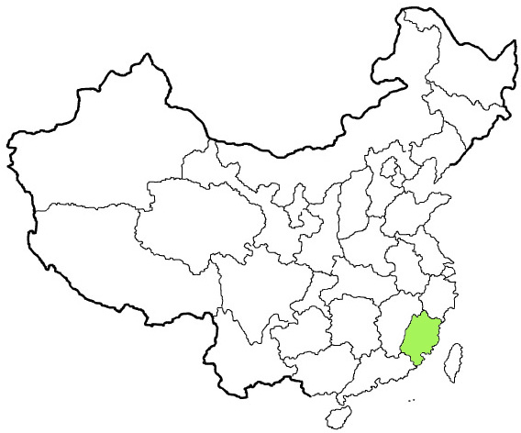
Fujian

Slide 25
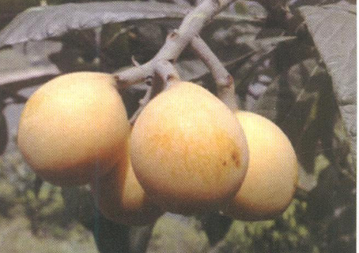
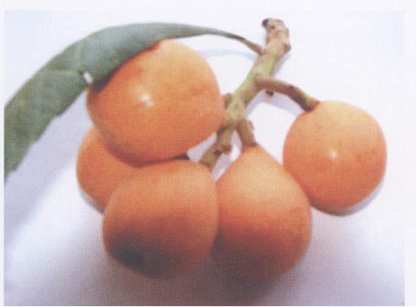
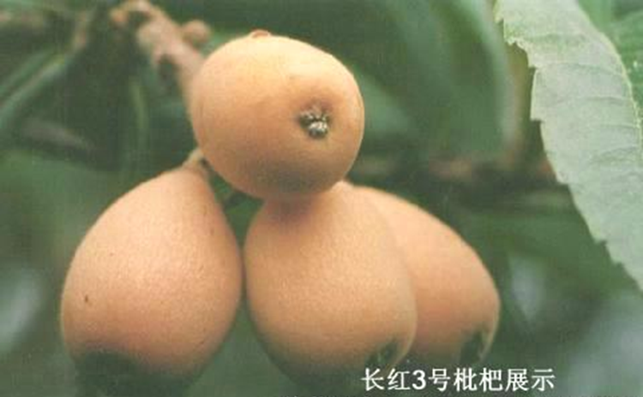
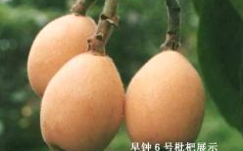
CHINA: Fujian Province
Yanhong
‘Jiefangzhong’ × ‘Gold Nugget
2009, 69g.
Orange, late, mid May
TSS :13.1%.
Disease resistance, high yield
Huangmi
Seedling, 2005, big fruit 63–121g
Whitish. Late, late-April to early-May
Edible rate: 73%. TSS: 13%
Thick peel, easy peel, resists fruit cracking, rust, sunburn; good storage & transport
Changhong No.3
Seedling, 1987, 50.1g. Yellowish
TSS: 8.9%
High yield, large fruit, thick fresh, disease resistance
Zaozhong No.6
‘Jiefangzhong’ × ‘Moriowase’, 1989
53–100g. Orange, Early (mid-April)
TSS: 11.9%. High yield
Melting, sweet, resistant to fruit rust & low temperature

Slide 26
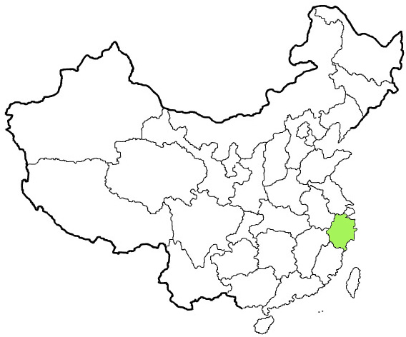
Zheijiang

Slide 27
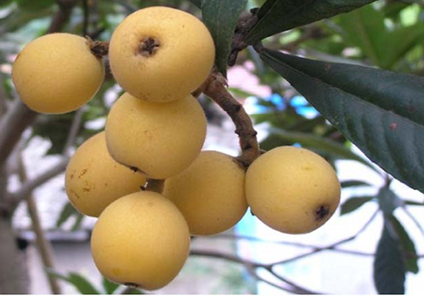
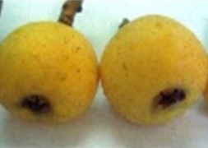
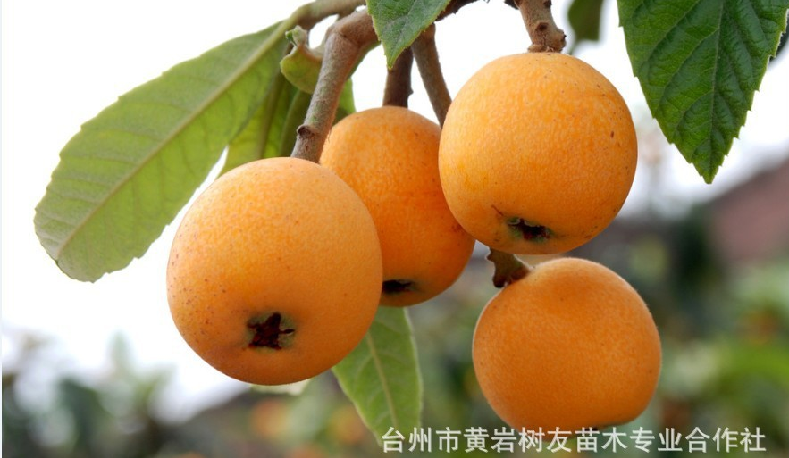
CHINA: Zheijiang Province
Ninghaibai
Seedling, 2004, 52g, Whitish
Late May to early June. TSS: 13–19%
Quality: Melting
Libai
Seedling, 1985, 45g, Whitish
Mid-late May. TSS: 14.2, 79% edible
Quality, tender, juicy, rich flavor
Resistant to leaf spot, fruit rust, sunburn
Dahongpao
Seedling, 1876, 45–100g
Yellow-orange, late May, TSS: 11%.
High yield, resistant to cold & drought
Easy to peel, thick flesh, good quality.
Subai No. 1
Seedling, new. 41g, Whitish
Late (early–mid June). TSS: 14.5%
Quality; high, juicy, sweet-sour, long storage

Slide 28
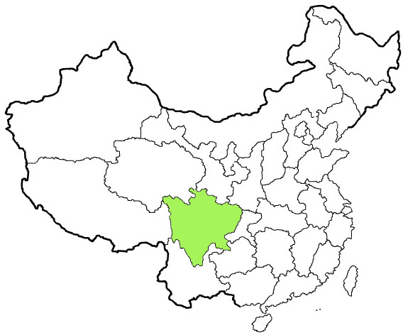
Sichuan

Slide 29
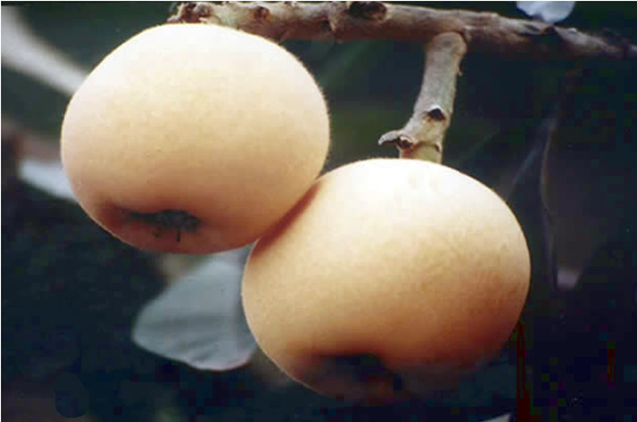
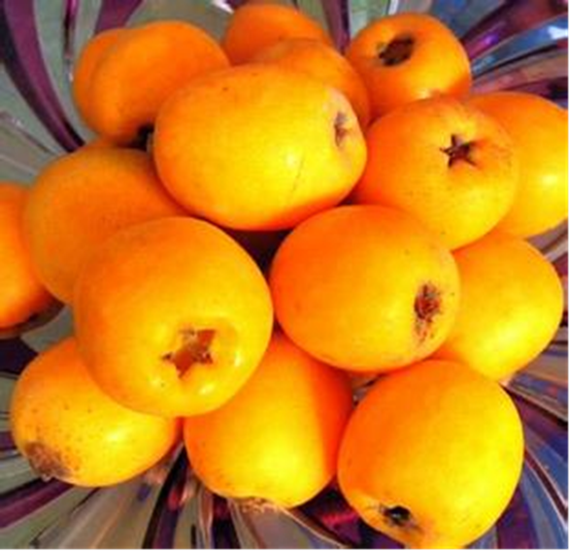
CHINA: Sichuan Province
Longquan No.1
Seedling, 2002, 58–69g
Yellow-orange Early (mid-May)
TSS: 11.4%, 71% edible
Large fruit, good taste, tender
Dawuxing
Seedling, 1978, 60–78g
Orange-red. TSS: 12–15%
Edible rate 73%. Late (May-June)
Easy peel, strong flavor, juicy, tender and delicate

Slide 30
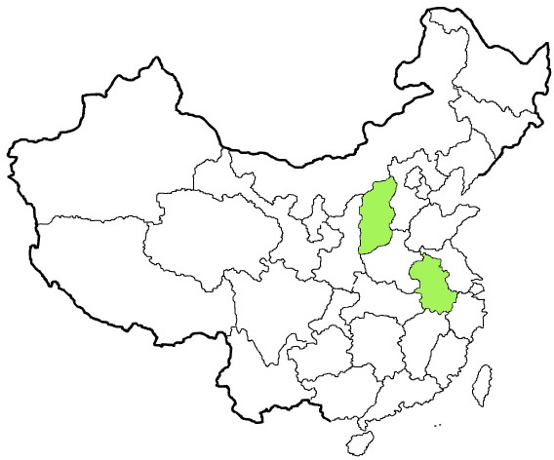
Shanxi
Anhui

Slide 31
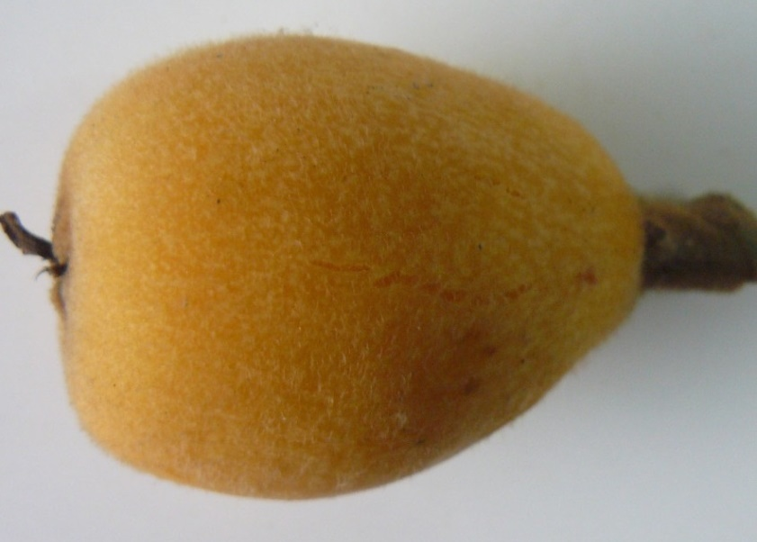
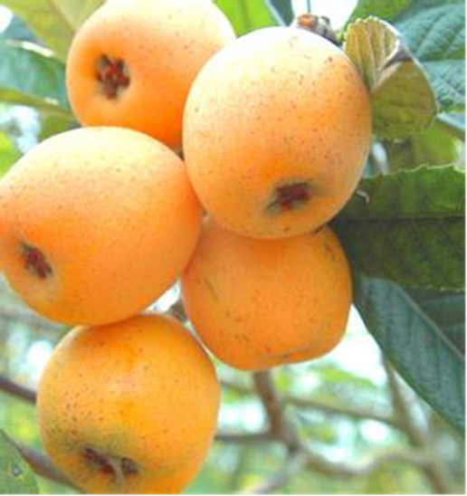
CHINA: Anhui Province
Guangrongzhong
Seedling, 45–80g
Yellow-orange. Mid-late May
TSS: 10%
High yield, resistant to cold & dry, good storage & transport
Easy peel, sweet-acid, good quality
CHINA: Shanxi Province
Maihouhuang
Seedling, 1995, 30–42g
Orange-red. TSS 12.0%
Edible rate 75%
Late (mid to late-June)
High yield, delicate, good taste

Slide 32
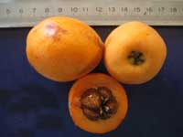
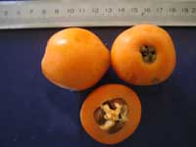
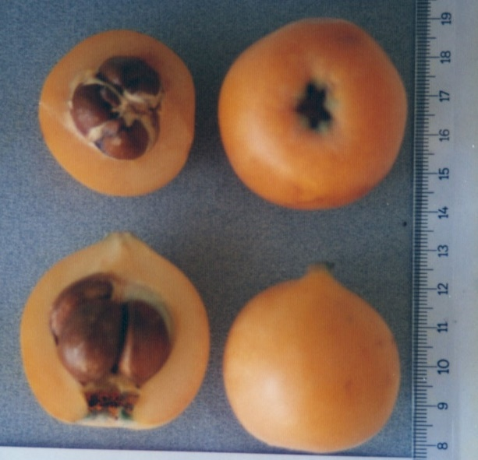
TURKEY
Akko I3
Japanese origin, 20–25g, 2–3 seed
Dark orange, yellow-red flesh
Sunburn
Juicy, sweet agreeable
flavor
Good keeping
Golden Nugget
Clone of Tanaka, California 1888–1890
Orange, yellow-red flesh
Juicy, sweet, agreeable apricot-like flavor
Good keeping, ships well
Hafif Cukurgobek
Seedling, Turkish selection
Orange, yellowish-red flesh
Sweet, juicy, pleasant flavor,
Good keeping

Slide 33
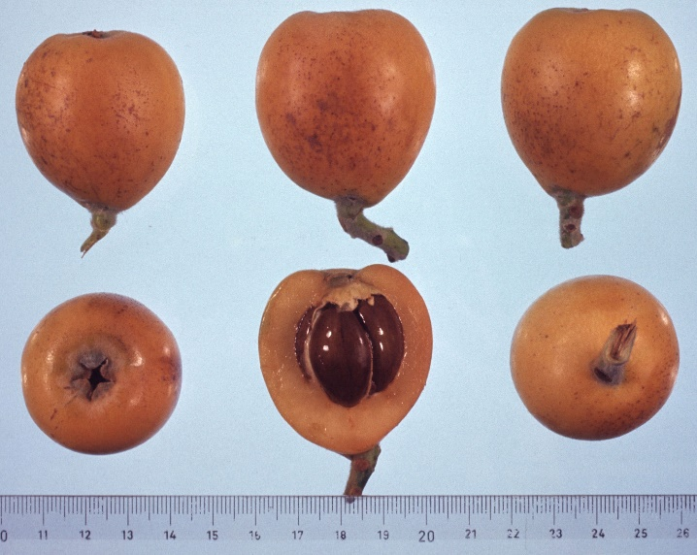
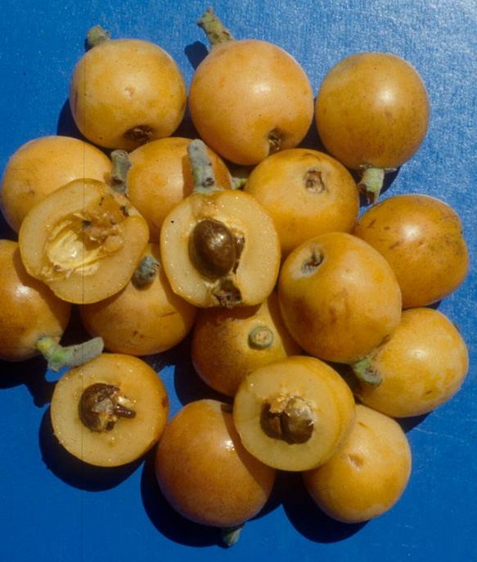
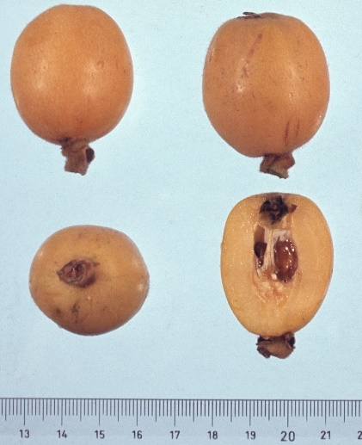
ITALY (Sicily)
Virticchiara
Seedling from Bocca di Falco (near Palermo)
Very early (April)
White-pink flesh, 45–50g, TSS: 9–10%
Sweet
Nespola Rossa
Seedling from Ficarfazzi (near Palermo)
End of April, (flowers Oct–Dec).
Pink flesh
TSS: 9–10%
Pollinator for Nespolone di Trabia and Sanfilliparo
Nespolone di Trabia
Seedling from Trabia (near Palermo)
May–June
Orange flesh, 60–80g
TSS: 14–15%
Very good quality, ships well

Slide 34


ITALY (Sicily)
Sanfilipparo (Gigante)
Derived and similar to Nespolone di Trabia
Orange flesh
Adaptable to different climates, ships well
Marchetto
Seedling from Facarazzi (near Palermo)
White orange flesh, 70–80g, TSS: 15%
Easy peel, ships poorly, local sales

Slide 35


SPAIN
Algerie
Seedling from Algeria, 65g, TSS: 11%
Yellow-orange fruit & flesh
Juicy, tasty, good sugar acid balance, good postharvest
High productivity 90% of Spanish production
Golden Nugget
Clone of Tanaka, California 1888–1890
Orange, yellow-red flesh
Juicy, sweet, agreeable apricot-like flavor
Good keeping, ships well

Slide 36


UNITED STATES (California)
Advance
Seedling, 1897 (C.P. Taft), Japanese origin
Late, Yellow–red flesh, self infertile
Downy skin, Medium size
Good pollinator
Excellent flavor, thick flesh
Dwarf tree
Champagne
Seedling, 1908 (C.P. Taft), Japanese origin
Mid-season to late
Yellowish-red flesh, 3–5 seed
Excellent flavor, juicy
Prolific

Slide 37

JAPAN (Honshu, Shikoku)
Tanaka
Seed from Nagasaki 1888
May (late in California), 70–80g, 2–4 seed
Yellow-red flesh, firm. Juicy, subacid, sweet
35% of crop in Japan, susceptible to sunburn

Slide 38



JAPAN (Kyushu)
Yougyoku
‘Mogi’ × ‘Morimoto’, 1973, released 1999
60g, TSS: 12%
Yellow flesh
Sensitive to loquat canker
Shiromogi
From Moki, seedling of Chinese loquat, 1840
Mid season
White flesh
Excellent quality
Nagasaki-wase
‘Mogi’ × ‘Hondawase’, 1976
Very early
Orange-orange yellow, yellow-red flesh
Excellent quality, good keeping

Slide 39


JAPAN (Kyushu)
Suzukaze
From ‘Kusunoki’ × ‘Mogi’, 1999, 55g Yellow flesh
Middle season, big fruit
Reigetsu
From Moriowase × , 2002, 51g
Yellow fresh
Mature in late April, easy to peel

Slide 40


JAPAN
Mizuho
‘Nao’ × ‘Tanaka’
Yellow flesh
Late season
Obusa
‘Tanaka’ × ‘Kushioki’, 1967, 70 g
Yellow flesh
Mid-season
Good keeping quality, resistant to insects & diseases

Slide 41

ISRAEL
Akko 1
Japanese origin
Midseason (April), 20–25g
Orange, slight russet
Thick flesh, 2 or 3 seed
Juicy , sunburn
Requires drastic thinning

Slide 42



ISRAEL
Akko 1
Midseason, 40–50 g
Sensitive to 'Purple spot'
Dark orange peel
Probably chance seedling from Akko farm, 1960s–1970s
Fruit pear shape
Relatively strong flavor
Yehuda
Midseason, 40-50 g
Probably Akko 1 × Akko 13, 1960s–1970s
Orange peel
Fruit shape oblong
Avri
Relatively late season
50–70 g (relatively large fruit)
Local chance seedling from Nordia nursery 1980s
Yellow-orange peel
Fruit pear shape

Slide 43

Seedless Loquat
Nonreduced gametes
(1/1000 seedlings are triploid)
Diploid × tretraploid crosses

Slide 44


Seedless loquat H324 (white fleshed)
Seedless loquat D425 (orange flesh) with diploid ‘Jinfeng’ at far right

Slide 45

Dr. Liang Guolu

Slide 46


Slide 47

Thank You
Jules Janick
janick@purdue.edu

